Slide 1
Chapter 6
Infectious diseases and Immunity

Slide 2
Outline
Infectious diseases
Infection and disease
Disease development and stages
Pathogenicity (primary and opportunistic pathogen)
The spread of infection
Types of infectious diseases
Modes of transmission
Host defenses against infection diseases

Slide 3
Infectious diseases
Diseases caused by living organisms called infectious agents like bacteria, viruses, fungi, protozoa, and helminthes and prions.
It occurs as the result of interactions between pathogenic microorganisms and the host
In order to cause infectious disease, a pathogen must accomplish the following steps
1. It must enter the host
2. It must metabolize and multiply on or in the host tissue
3. It must resist host defenses
4. It must damage the host

Slide 4
Principles of infectious diseases
Infection and disease
The terms "infection" and "disease" are not synonymous
Infection results when a pathogen enters and begins growing within a host
Disease occurs when the cells in host body are damaged, tissue function is impaired as a result of the infection and signs and symptoms of an illness appear

Slide 5
Cont’d
Symptom
A change in body function that is felt by a patient as a result of disease
Sign
A change in a body that can be measured or observed as a result of disease
Syndrome
A specific group of signs and symptoms that accompany a disease

Slide 6
Classification of infectious diseases
Number of criteria can be used to classify infectious diseases
1. Based on transmission potential
Communicable disease
a disease that is spread from one host to another
Contagious disease
a disease that is easily spread from one host to another
Non-communicable disease
a disease that is not transmitted from one host to another

Slide 7
Cont’d
2. Based on occurrence of diseases
Sporadic disease
disease that occurs occasionally in a population
Endemic disease
disease constantly present in a population
Epidemic disease
disease acquired by many hosts in a given area in a short time
Pandemic disease
worldwide epidemic

Slide 8
Cont’d
Incidence
fraction of a population that contracts a disease during a specific time
number of new cases of a disease or disorder
Prevalence
fraction of a population having a specific disease at a given time
number of existing cases

Slide 9
Cont’d
3. Severity or duration of infectious disease
Acute
disease develops rapidly
Chronic
disease develops slowly
Subacute
symptoms appear between acute and chronic
Latent
disease with a period of no symptoms when the causative agent is inactive

Slide 10
Cont’d
4. Extent of infection in the host
1. Local infection
Pathogens are limited to a small area of the body
2. Systemic infection
An infection throughout the body by blood and/or lymph
Bacteremia: presence of bacteria in the blood
Septicemia: presence and growth of bacteria in the blood
Toxemia: toxins in the blood
Viremia: viruses in the blood
3. Focal infection
Systemic infection that began as a local infection and moves via blood or lymph to set up a new infection at another site
tooth infection

Slide 11
Cont’d
5. Pathogenicity
Primary pathogen
microbe or virus that causes disease in healthy individual
Opportunistic pathogen (opportunist)
microbes that causes disease only when body‘s innate or adaptive defenses are compromised

Slide 12
Disease development and stages
1. Incubation period
time interval between initial infection and first appearance of signs and symptoms
2. Prodromal period
characterized by appearance of first mild signs and symptoms
3. Period of illness
disease at its height
4. Period of decline
signs and symptoms subside
5. Period of convalescence
body returns to pre diseased state, health is restored

Slide 13
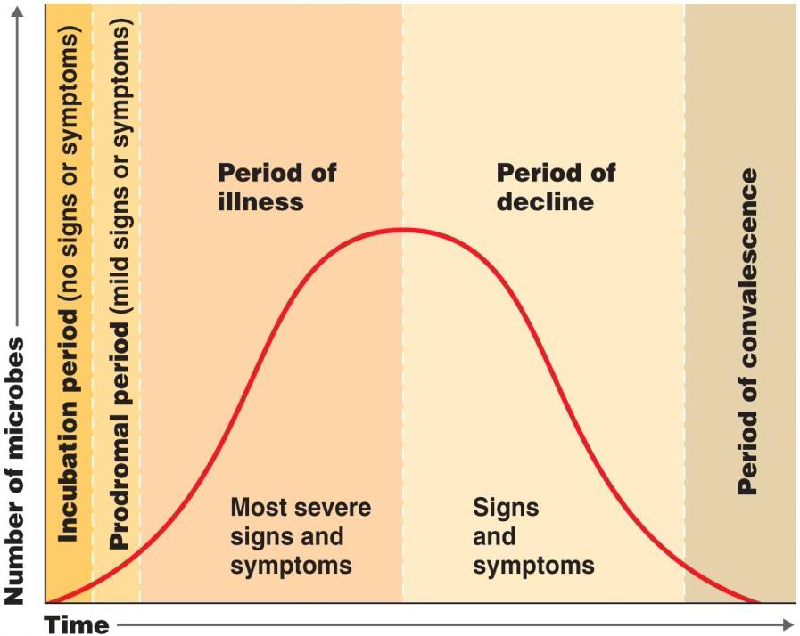

Slide 14
The spread of infection
Human reservoirs of infection
people who have a disease or carriers of pathogenic microorganisms
Sick people
Carriers
Latent infection carriers

Slide 15
The spread of infection cont’d
2. Zoonosis
diseases that affect wild and domestic animals and can be transmitted to humans
Direct contact with animal or its waste
Eating animals
Blood sucking arthropods
3. Non-living reservoirs
soil, water, and food can be reservoirs of infection
Presence of microorganisms is often due to contamination by feces or urine

Slide 16
Types of infectious disease and their causative agent
Causative agent is an agent responsible for development of disease
The common pathogens known as causative agents for different types of infectious diseases are:
Bacteria, viruses, fungi, helminths, protozoa and prion

Slide 17
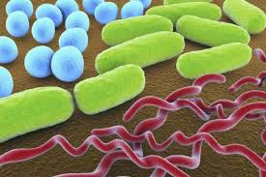
1. Bacteria
Are unicellular prokaryotic organisms reproduce by binary fission
The three most common shapes of bacteria are:
bacillus (rod-shaped), coccus (spherical), or spirillum (helical rods)

Slide 18
Cont’d
Based on their cell wall structures, which influences their Gram stain reaction, bacteria can be:
Gram-negative
Appear pink after the staining procedure
Salmonella typhi : causes typhoid fever
Yersinia pestis: causes plague
2. Gram-positive bacteria
Appear purple after Gram staining procedure
Staphylococcus aureus
causes skin, respiratory and wound infections
Clostridium tetani
produces a toxin that can be lethal for humans

Slide 19
Bacterial association with the host
Some of them live inside the human body without causing harm (normal flora)
Some bacteria attack other bacteria and prevent them from causing sickness
Some bacterial cause diseases like:
Cholera, diphtheria, Dysentery, bubonic plague, Pneumonia, Tuberculosis, Typhoid, Typhus and etc
NB. Bacterial infections can be treated with antibiotics

Slide 20
2. Viruses
are not living organisms because,
apart from a host cell, they have no metabolic capability and cannot reproduce
Viruses are classified using a variety of criteria, including shape, size, and type of genome
Viral genomes may be:
Double or single-stranded DNA (a DNA virus) or
double- or single-stranded RNA (an RNA virus)

Slide 21
The general viral process of infection and replication
1. DNA virus
1. Viral particle first attaches to a specific host cell
2. The viral genome is then inserted into the host cell,
3. Reproduce, then
4. The new viruses are released from the host cell
The new viruses can be released through either of the two situations
1. In some cases, virus-derived enzymes destroy the host cell membranes, killing the cell and releasing the new virus particles
2. In other cases, new virus particles exit the cell by a budding process, weakening but not destroying the cell

Slide 22
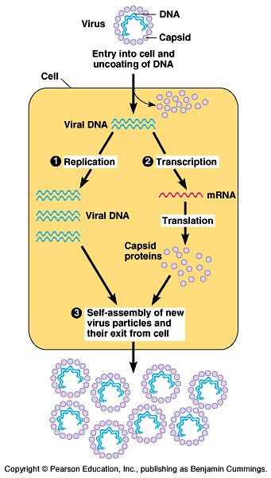

Slide 23
2. RNA viruses
Genetic material can be used directly as messenger RNA to produce viral proteins
RNA viruses that cause human disease include
rhinoviruses: cause most common colds
myxoviruses and paramyxoviruses that cause influenza, measles, and mumps
rotaviruses: cause gastroenteritis

Slide 24
Cont’d
Retroviruses, use a unique enzyme called reverse transcriptase to copy the RNA genome into DNA
This DNA then integrates itself into the host cell genome
E.g. the human immunodeficiency virus (HIV)
Viruses cause disease by disrupting normal cell function. They do this in a variety of ways
Some viruses make repressor proteins that stop the synthesis of the host cell's proteins, RNA and DNA

Slide 25
Cont’d
2. Some viruses change the function of the host cell
E.g. human papillomavirus can lead to cancer by forcing cells to replicate in an uncontrolled way
3. Viral activity may weakens cell membranes and lysosomal membranes, leading to cell autolysis
Antiviral medications help in some cases
They can either prevent the virus from reproducing or boost the host's immune system

Slide 26
3. Fungi
Fungi are eukaryotic, heterotrophic organisms that have cell walls made from chitin
Reproduce primarily by forming spores
Most fungi are multicellular, although some, such as yeasts, are unicellular
Many fungal infections appear in the upper layers of the skin, and some progress to the deeper layers

Slide 27
Fungi cont’d
Inhaled fungal spores can lead to systemic fungal infections
Many fungi infect plants and animals
Examples of diseases caused by fungi are ringworm and histoplasmosis

Slide 28
4. Protozoa
unicellular, heterotrophic eukaryotes that include
amoeba and paramecium
do not have cell walls
protozoa can be acquired through
Contaminated food or water
Bite of an infected arthropod
E.g. Malaria

Slide 29
5. Helminths
Simple, invertebrate animals, some of which are infectious parasites
They are multicellular and have differentiated tissues
Their physiology is similar in some ways to human
This makes parasitic helminth infections difficult to treat because drugs that kill helminths are frequently very toxic to human cells

Slide 30
Helminths cont’d
Many helminths have complex reproductive cycles that include multiple stages, many or all of which require a host
The common helminthes are
Ascaries
Tape worm
Hook worm
Schistosoma etc

Slide 31
6. Prions
protein that contains no genetic material
do not replicate or feed on the host but trigger abnormal behavior in the body's cells and proteins
It is normally harmless, but if it folds into an abnormal shape, it can become a rogue agent and
affect the structure of the brain or other parts of the nervous system

Slide 32
Prions cont’d
The known prion diseases include
Creutzfeldt-Jakob disease (in humans)
scrapie (in sheep) and
bovine spongiform encephalopathy ("mad cow disease" in cattle)
Mode of transmission can be:
inherited
infection from
eating infected tissue or
medical procedures such as tissue transplants

Slide 33
Modes of transmission
Infectious agents may be transmitted through
Horizontal transmission
infectious agent is passed from person to person in a group
A. Direct
Direct contact occurs when an individual is infected by contact with the reservoir by
Touching an infected person
Ingesting infected meat
Biting by an infected animal or insect
Inhaling the infectious agent in droplets
Intimate sexual contact
Some diseases that are transmitted primarily by direct contact include
Ringworm, AIDS, Influenza, Rabies and Malaria

Slide 34
B. Indirect contact
Occurs when a pathogen can withstand the environment outside its host for a long period of time before infecting another individual
Indirect mode of transmission can be achieved through:
Contaminated inanimate objects
Contaminated food and beverages
Sewage-contaminated water
Diseases that are transmitted by indirect contact include
Cholera
Rotavirus infection
Cryptosporidiosis and
Giardiasis

Slide 35
2. Vertical transmission
Transmission of disease from parent to child during
Reproduction and fetal development
Diseases in which vertical transmission occurs include
herpes encephalitis (which occurs when an infant contracts the herpes simplex type II virus during birth)

Slide 36
Host defenses against infectious diseases
Immunity
the ability to ward off damage or disease
Immune system
set of cellular and humoral components to defend the body against foreign substances
Immune system has two lines of defense against pathogens
Innate and
Adaptive, both divided into cell mediated defense and humoral defense factors
These two systems work together in order to destroy invaders or to trigger defense processes

Slide 37
Innate Immune system
Comprises cells and mechanisms that defend the host from infection by other organisms in a non-specific manner
designed to prevent microbes from entering the body and to help eliminate those that do gain access
Have the following characters
Faster
Non-specific
No memory component developed/retains no memory of previous infection
Duration of the immune response is over a short period

Slide 38
Innate Immune system cont’d
It is commonly divided into four compartments
Mechanical barriers
Humoral parameters
Cellular components
Fever and Inflammation

Slide 39
1. Mechanical Barriers
Skin and mucous membranes
provide both physical and chemical barriers that discourage pathogens from penetrating the body and causing disease
Skin
Epidermis of skin provides a formidable physical barrier to the entrance of microbes

Slide 40
Mechanical Barriers cont’d
Mucous membranes
The epithelial layer of mucous membranes secretes a fluid called mucus which traps many microbes and foreign substances
The mucous membrane of nose has mucus-coated hairs
Upper respiratory tract contains cilia
trap and filter microbes, dust, and pollutants from inhaled air
Coughing and sneezing accelerate movement of mucus and its entrapped pathogens out of the body

Slide 41
2. Humoral component (chemical Barriers)
Contains a variety of proteins capable of destroying or inhibiting growth of infectious microorganisms, which include
Lysozyme
Acts on the peptidoglycan of pathogens cell wall
Complement system proteins
Comprised of soluble and membrane proteins that destroy pathogens through membrane injuries, commonly characterized by pores

Slide 42
Humoral component (Chemical Barriers) cont’d
Interferons
Interfere with viral replication
Anti-proteases
Against microorganism proteolytic proteins
C-reactive protein
promoting pathogen opsonization, complement activation and phagocytosis

Slide 43
3.Cellular components
Phagocytes that may mobilized to the inflammation site by molecular signals includes
1. Natural Killer Cells
Immune cells present in blood, spleen, lymph nodes, and bone marrow
NK cells attack any body cells that display abnormal or unusual plasma membrane proteins
2. Phagocytes
Specialized cells that perform phagocytosis
The two major types of phagocytes are
Neutrophils and
Macrophages

Slide 44
4. Fever and Inflammation
Fever and Inflammation offers powerful protection against infection by interfering with the proper conditions that promote bacterial growth
During fever
The amount of iron in the blood is reduced, and thus fewer nutrients are available to support the growth of pathogens
Phagocytic cells attack with greater vigor when the temperature rises

Slide 45
Fever and Inflammation cont’d
During an inflammation
Dilation of blood vessels occurs
increase of blood volume in affected areas
invasion of white blood cells into the affected area
Characterized by redness, swelling, heat, and pain

Slide 46
Adaptive immunity
Ability of the body to defend itself against specific invading agents
Have the following characters
Specific
for particular foreign molecules (antigens)
distinguish self from non-self molecules
Memory component developed
Duration of the immune response is over a long period (some times lifetime)

Slide 47
Cont’d
Adaptive immunity depends on specialized white blood cells called lymphocytes
T-cells and B-cells
There are two major types of mature T cells that exit the thymus
Helper T cells (CD4)
Cytotoxic T cells (CD8)

Slide 48
Cont’d
Components of adaptive immunity
1. Cell-mediated immunity
involves T-cells
Responsible for
Directly destroying body cells that are infected with a pathogen or have become cancerous
Activate other immune cells to be more efficient microbe killers
2. Antibody-mediated immunity
involves both T-cells and B-cells
Responsible for
Destruction of invading pathogens
Elimination of toxins

Slide 49
Cont’d
Both the cell-mediated and antibody-mediated responses are initiated after macrophage engulfs a pathogen and then display antigens from the pathogen on their surface.
This display helps the macrophages stimulate specific helper T-cells to release signal molecules called lymphokines
The lymphokines, in turn, stimulate the cell-mediated and antibody-mediated responses

Slide 50
Cont’d
Lymphokine-stimulated killer T-cells attach to the pathogen-infected cells and destroy them, whereas
lymphokine-activated phagocytic cells produce more toxic molecules that can kill the pathogen directly
The antibody-mediated response occurs when the lymphokines activate specific B-cells to produce antibodies
These antibodies attach to antigens on the surface of the pathogens and signal attack by phagocytic cells and complement system. Other B-cells go on to become memory B-cells, which respond quickly by producing more antibodies upon subsequent infection.

Slide 51
Immunological disorders
The aim of the immune responses is to protect the body from damage that may cause by any environmental agents including pathogens
But sometimes adverse immunological reactions can occur and cause adverse effects to the host due to:
Exaggerated immune response and/or producing inappropriate immune response against self-components
Failure of appropriate recognition mechanism
In general, there are three types of immunological disorders
Hypersensitivity
Autoimmune diseases
Immunodeficiency

Slide 52
Hypersensitivity reactions
Hypersensitivity is an immunological state in which the immune system “over-reacts” to foreign antigen such that the immune response itself is more harmful than the antigen
Causes inappropriate and/or excessive tissue damage
All types of hypersensitivity involve
The adaptive immune response (highly specific reactions via T or B cells)
Prior exposure to the antigen the initial exposure sensitizes the individual but does NOT cause a hypersensitive reaction
Hypersensitivity is only seen on secondary exposure

Slide 53
Hypersensitivity following secondary exposure to antigen comes in 4 basic forms
Type I:
allergic reactions(“immediate”hypersensitivity)
IgE mediated and very rapid (2-30 minutes)
Type II: cytotoxic reactions
cell damage due to complement activation via IgM or IgG
Type III: immune complex reactions
cell damage due to excess antibody/antigen complexes
Type IV: delayed cell-mediated reactions
cell damage involving T cells & macrophages
Types I-III are all antibody-mediated, Type IV is not!

Slide 54
Autoimmune disorders
A condition that occurs when the immune system mistakenly attacks and destroys healthy body tissue
immune system fails to recognize a protein as “self” and launches an attack
Autoimmune disorders are chronic and usually irreversible but drugs can help slow the progress of these diseases
Examples autoimmune disorders
Multiple sclerosis
Lupus, and
Rheumatoid arthritis are examples

Slide 55
Immunodeficiency
Loss or inadequate function of various components of the immune system
Can occur in any part or state of the immune system
physical barrier, phagocytes, B lymphocytes, T lymphocytes, complement, natural killer cells
Classified as primary or secondary
1. primary (congenital) immunodeficiency
Genetic abnormality caused by mutations affecting any of a large number of genes that control the expression and activities of immune responses
can affect either the lymphoid or the myeloid lineages

Slide 56
Defects in lymphoid lineage
involve B-cell, T-cell or both
B-Cell immunodeficiency
T-cell deficiencies
Defects in myeloid linage
Affect innate immunity, especially phagocytic activity.
Chronic granulomatos disease (CGD)
Complement deficiencies
2. Secondary (Acquired) immunodeficiency
Results from infections, nutritional deficiencies or treatments
AIDS, chronic leukemia

Slide 57
Tumor Immunology
Cancer is a disease in which cells, almost anywhere in the body, begin to divide uncontrollably
A tumor is when this uncontrolled growth occurs in solid tissue such as an organ, muscle, or bone
Most cancers form a lump called a tumor
Lumps that are not cancer are called benign
Lumps that are cancer are called malignant

Slide 58
Tumor Immunology cont’d
There are some cancers, like leukemia that don't form tumors
Tumor immunology immune surveillance is a concept that envisages prevention of the development of the most tumors through early destruction of abnormal cells by the host's immune system
Surveillance probably acts against viruses not tumors

Slide 59
In order for the immune system to react against a tumor, the latter must have antigens that are recognized as a foreign
There are two main types of tumor antigens:
Tumor-specific transplantation antigens (TSTA) which are
unique to tumor cells and not expressed on normal cells
They are responsible for rejection of the tumor
2. Tumor associated transplantation antigens (TATA)
expressed by tumor cells and normal cells

